Slide 1


Towards a Model for Predicting Overland Trafficking Routes Cornell, Harry Necaise, Aaron Robkin, Jessica Vaz, Karina IDS 6916 Research Practicum Alpha Presentation

Slide 2
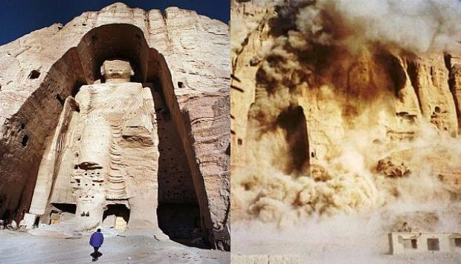
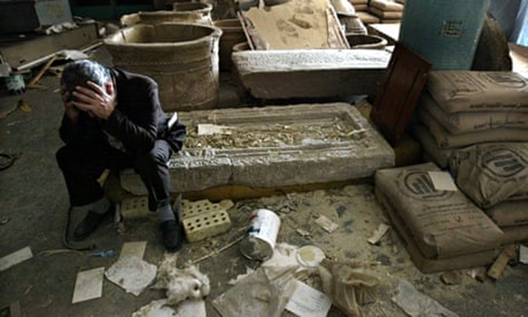
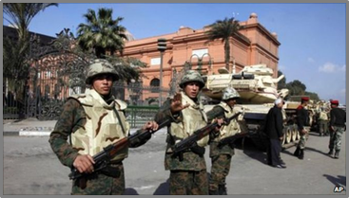
Introduction - Terrorism and the Theft of Cultural Heritage
Regional background
Arab Spring
Syrian Civil War
Casana, 2015; Luke & Kersel, 2005; Parcak et al., 2016; Terrill, 2017
Destruction of Bamiyan Buddhas, 2003
Mosul Museum, 2013
Cairo Museum, 2011
Notes:
Since the beginning of the Syrian Civil war in 2011, extremist groups have taken advantage of the chaos and instability to loot and destroy archaeological sites and museums throughout Syria and into parts of Iraq, the most notable widely covered of which have been the 2014-2015 capture of Mosul and subsequent destruction of the Mosul Museum and Library.
In 2015, ISIS took bulldozers and explosives to Nimrud, vandalizing Hatra, Nineveh, Khorsabad, and others. The destruction of Palmyra in 2016 was another devastating blow to world cultural heritage.
While the primary players in this story that we are all familiar with are Al-Qaeda and ISIS, we must not forget the importance of local gangs of organized looters, as well as subsistence looters, that take advantage of inadequately protected cultural property to loot for a variety of reasons.
So, why is this happening?
The reasons why the destruction and looting of cultural property is happening both in the Middle East and across the globe seem to fall into a number of categories.
Failure to protect archaeological sites and cultural property, poverty, religious ideology, propaganda, and last, but most certainly not least, supply and demand, are some of the contributing factors of this issue
Extremist Muslim groups have used religious ideology as a driving motivation for destruction of idolatrous heritage. The Taliban made no qualms about destroying the Bamiyan Buddhas in Afghanistan for just this very reason.

Slide 3
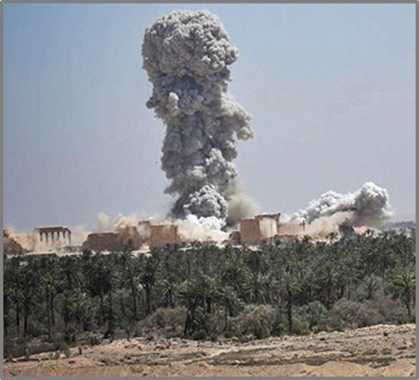
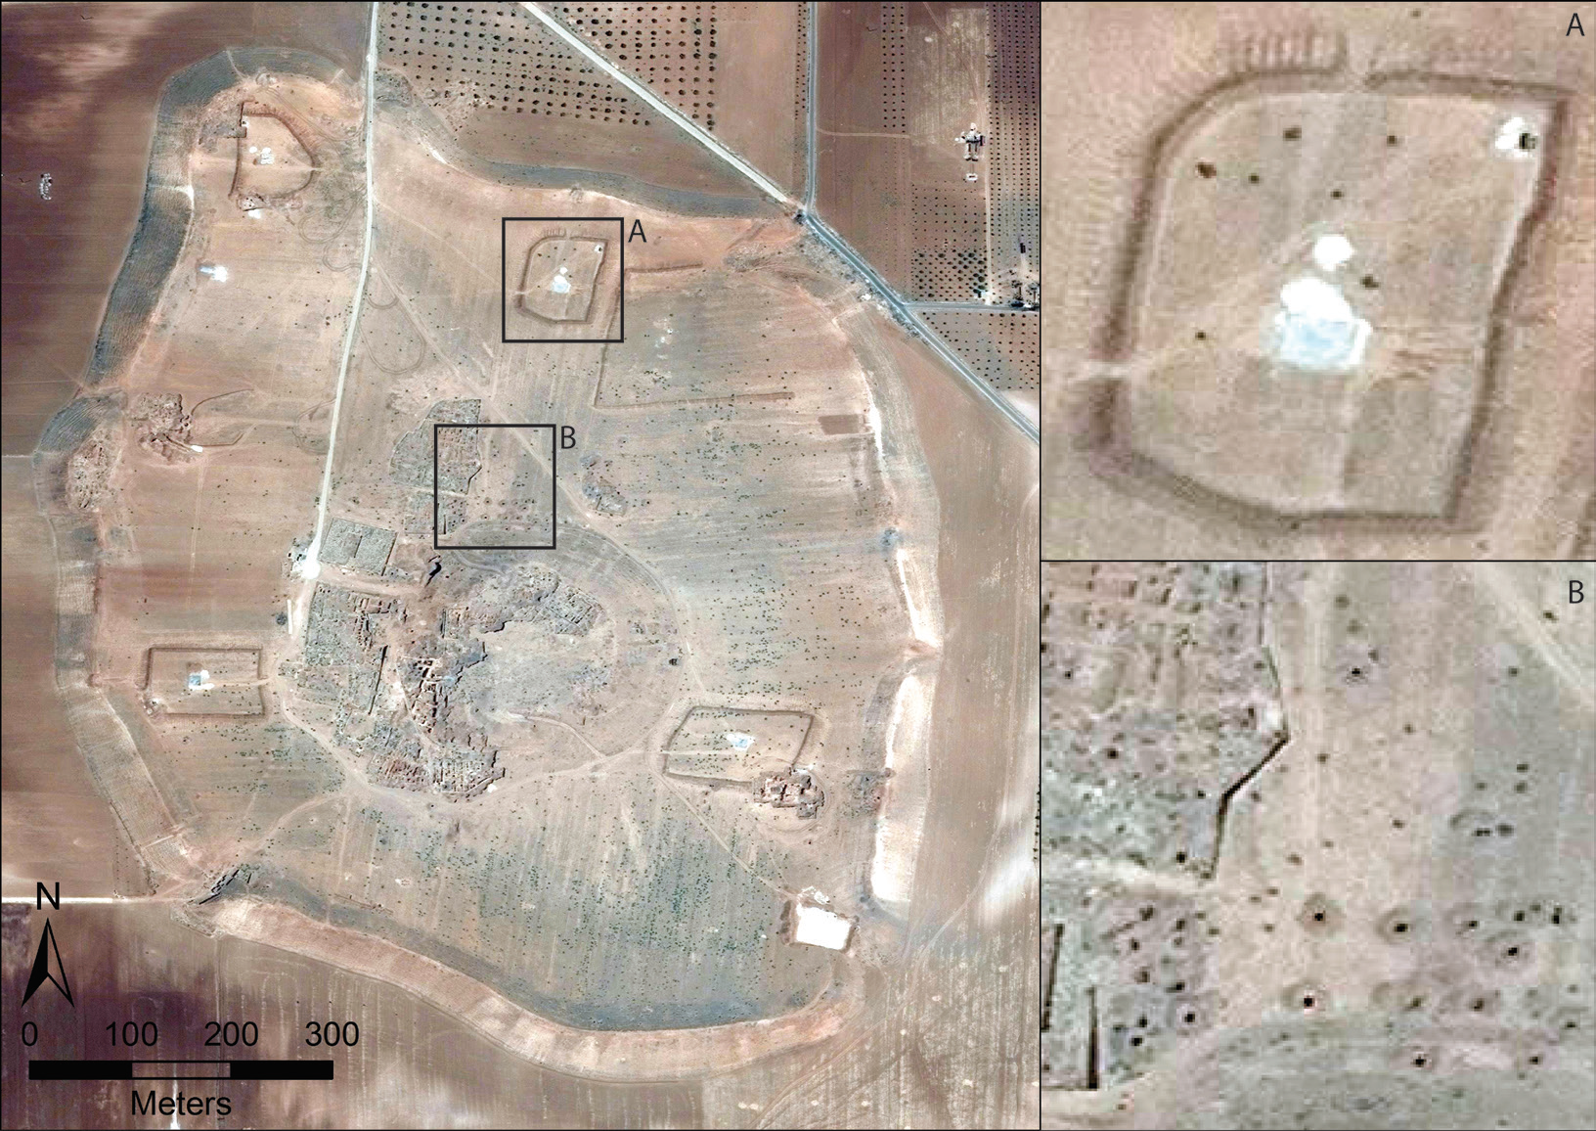
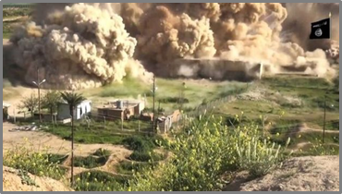
Introduction - Looting and the Funding of Terrorism
Al Qaeda
ISIS
Casana, 2015; Luke & Kersel, 2005; Parcak et al., 2016
Long-term repercussions (Terrill, 2017)
Destruction of Palmyra, 2016
Satellite imagery of the Bronze Age city of Elba, 2014
Isis propaganda image of destruction at Nimrud, 2015
Notes:
Recently, however, the rise of criminal iconoclasm has returned to the world stage with ISIS taking the lead in destruction of idolatrous cultural sites that they say must be eradicated from a true Islamic state. While they preach their message, in reality, they are destroying these sites for propaganda opportunities used to recruit forces and obtain donations from sympathizers to their cause. Poverty plays a role here. The abject poverty in much of the Middle East forces economically deprived villagers not only into the well-paying arms of ISIS, but also into subsistence looting in efforts to support themselves and their families.
Most importantly, one of the primary drivers in this equation is the law of supply and demand. Private collectors, museums and auction houses from the U.S. to the UK and Japan have an insatiable appetite for cultural property. Regardless of the numerous laws in many countries making trade in illicit antiquities a punishable crime, it is often very easy for collectors and museums to work around a lack of provenience. The simple fact is, if there was no demand for these objects, the extremist groups and opportunistic looters would have nowhere to sell their ill-gotten goods and cultural property might be spared.
The long-term repercussions of this theft are multifaceted. The act of looting destroys all archaeological context the artifacts may have had – thereby eradicating much of the information that archaeologist use to understand the where, when, and why questions that arise when trying to reconstruct past lifeways. Further, the funds from the illicit antiquities trade stock the coffers of terrorist organizations, allowing them to continue their missions of chaos and destruction. Additionally, an often forgotten repercussion of these acts is the destruction of the shared cultural identity that these objects and locations represent. The loss of cultural identity destabilizes the very make-up of society, thereby furthering the goals of extremist groups and limiting the abilities of social reconstruction.

Slide 4
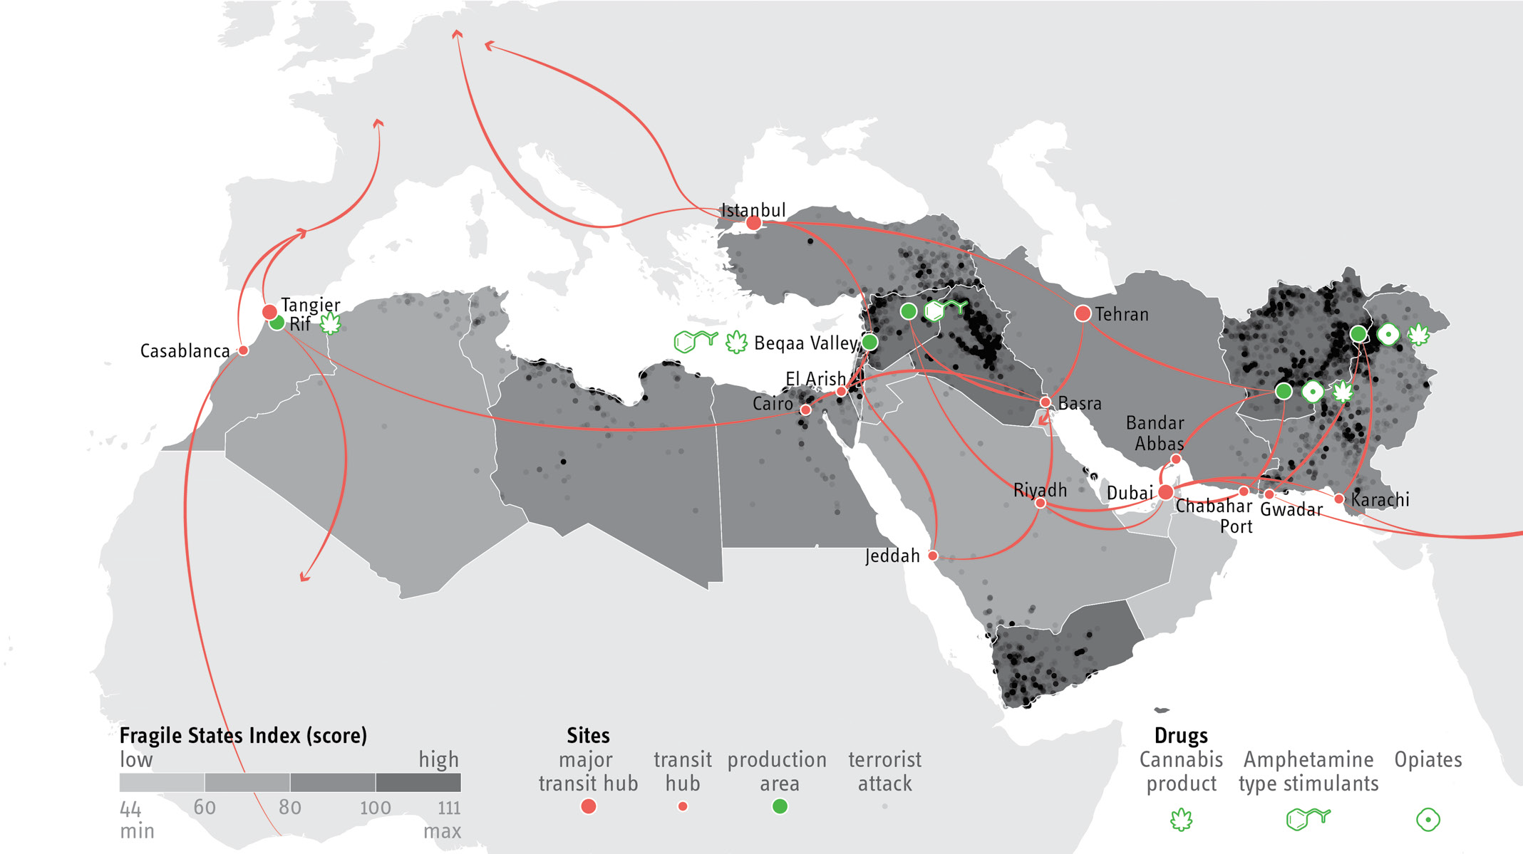
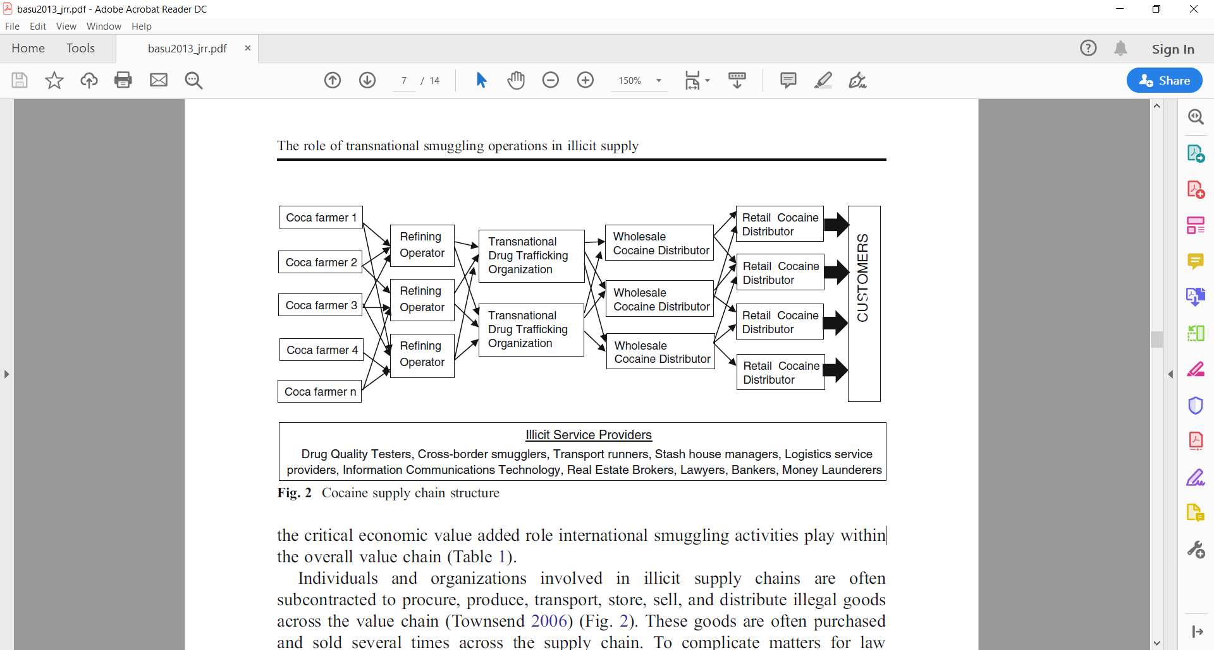
Introduction - Transnational Smuggling and Overland Trafficking
Glocal - Middlemen - Beyond (Alderman, 2012; Proulx, 2013)
Decision-making for overland trafficking (Basu, 2013, 2014)
Trafficking through the Middle East and North Africa (MENA region)
Cocaine supply chain structure (Basu, 2013)

Slide 5
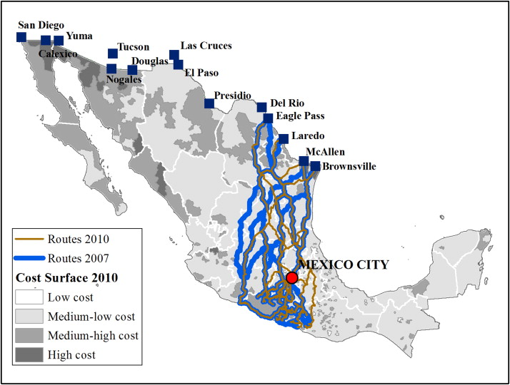
Topic / Purpose Statement
The intent of this line of work is to use computer simulations to help law enforcement and cultural heritage workers recover looted artifacts by identifying the most probable overland smuggling routes.

Slide 6
Central Research Question
Is it possible to accurately predict the travel patterns of smugglers using computer routing models?
Subtopics:
What factors influence routing decisions and to what degree?
How do these decisions differ across regions?
Can these methods be applied to intercept looted artifacts in the MENA region?
Approach:
Qualitative:
Graph-theory to develop routes
Survey / questionnaires

Slide 7
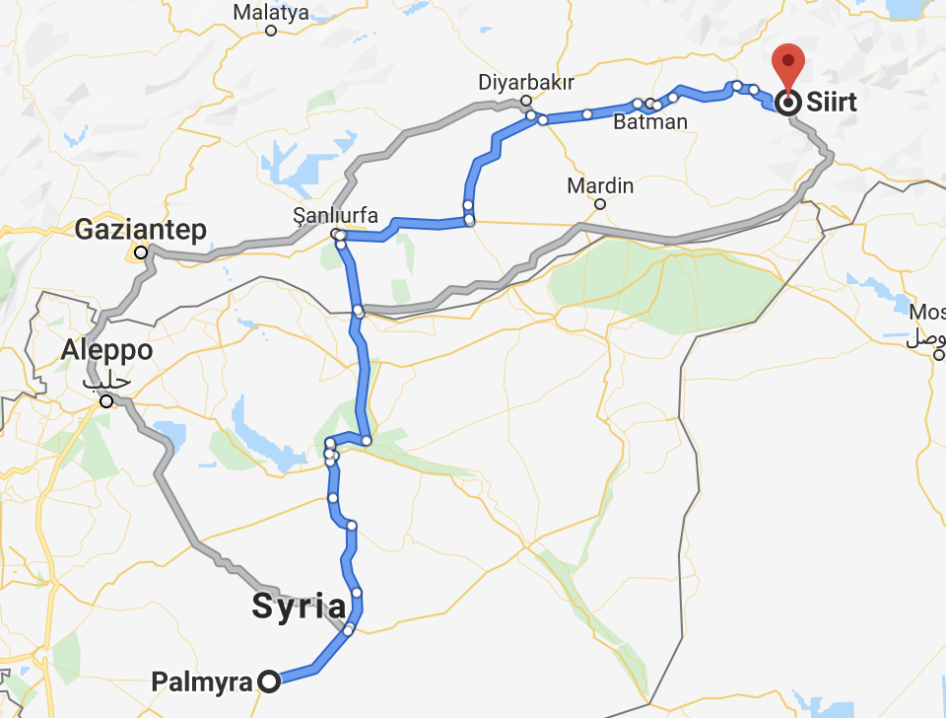
Hypothesis 1
Problem:
Considering the regional instability in the MENA region, standard shortest-path models may not be viable
Local smuggling routes are likely dependent on the other criminal activity in the region
Weak Points in border security
Enemy faction presence in an area
Route exposure to policing officials
Notes:
Since the beginning of the Syrian Civil war in 2011, extremist groups have taken advantage of the chaos and instability to loot and destroy archaeological sites and museums throughout Syria and into parts of Iraq, the most notable widely covered of which have been the 2014-2015 capture of Mosul and subsequent destruction of the Mosul Museum and Library.
• In 2015, ISIS took bulldozers and explosives to Nimrud, vandalizing Hatra, Nineveh, Khorsabad, and others. The destruction of Palmyra in 2016 was another devastating blow to world cultural heritage.
• While the primary players in this story that we are all familiar with are Al-Qaeda and ISIS, we must not forget the importance of local gangs of organized looters, as well as subsistence looters, that take advantage of inadequately protected cultural property to loot for a variety of reasons.
• So, why is this happening?
• The reasons why the destruction and looting of cultural property is happening both in the Middle East and across the globe seem to fall into a number of categories.
• Failure to protect archaeological sites and cultural property, poverty, religious ideology, propaganda, and last, but most certainly not least, supply and demand, are some of the contributing factors of this issue
• One of the biggest deterring forces to organized gangs of looters is site protection. Looters often avoid the hassle of sites that are actively policed by military or armed forces. During periods of political unrest, cultural heritage sites are often left unprotected as military and police resources are deployed to areas of greater need, making cultural property easy prey.
• Extremist Muslim groups have used religious ideology as a driving motivation for destruction of idolatrous heritage. The Taliban made no qualms about destroying the Bamiyan Buddhas in Afghanistan for just this very reason.
• Recently, however, the rise of criminal iconoclasm has returned to the world stage with ISIS taking the lead in destruction of idolatrous cultural sites that they say must be eradicated from a true Islamic state. While they preach their message, in reality, they are destroying these sites for propaganda opportunities used to recruit forces and obtain donations from sympathizers to their cause. Poverty plays a role here. The abject poverty in much of the Middle East forces economically deprived villagers not only into the well-paying arms of ISIS, but also into subsistence looting in efforts to support themselves and their families.
• Most importantly, one of the primary drivers in this equation is the law of supply and demand. Private collectors, museums and auction houses from the U.S. to the UK and Japan have an insatiable appetite for cultural property. Regardless of the numerous laws in many countries making trade in illicit antiquities a punishable crime, it is often very easy for collectors and museums to work around a lack of provenience. The simple fact is, if there was no demand for these objects, the extremist groups and opportunistic looters would have nowhere to sell their ill-gotten goods and cultural property might be spared.

Slide 8
Hypothesis 1
Problem:
Considering the regional instability in the MENA region, standard shortest-path models may not be viable
Local smuggling routes are likely dependent on the other criminal activity in the region
Weak Points in border security
Enemy faction presence in an area
Route exposure to policing officials
H1:
Incorporating these regional factors into a shortest-path routing graph model will lead to improved prediction of smuggling paths.

Slide 9
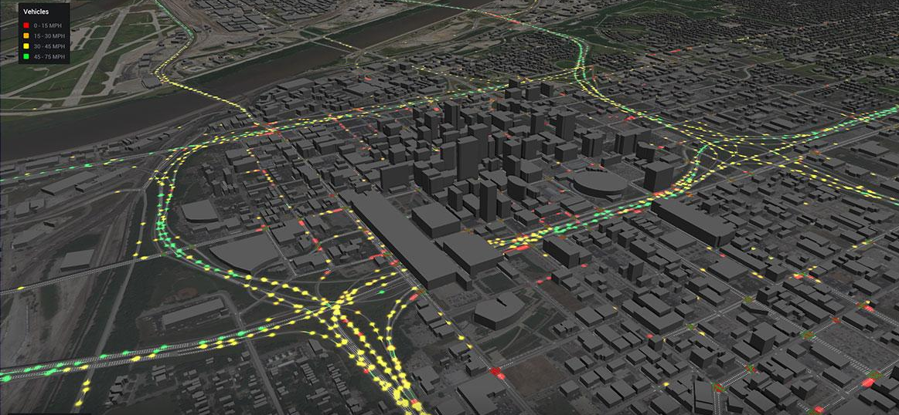
Hypothesis 2
Problem:
A major challenge for our model will be validation
While we’ve identified several contributing variables, the effect size of these variables is unclear
Approach:
Forced-choice survey where participants are asked to choose routes based on several variations in the IVs
These results can serve as a ‘sanity check’ and also inform our model inputs moving forward

Slide 10
Hypothesis 2
Problem:
A major challenge for our model will be validation
While we’ve identified several contributing variables, the effect size of these variables is unclear
Approach:
Forced-choice survey where participants are asked to choose routes based on several variations in the IVs
These results can serve as a ‘sanity check’ and also inform our model inputs moving forward
H2:
Enemy faction presence will be the strongest deterrent towards taking a path.

Slide 11

Hypothesis 3
Problem:
While we have information about trafficking in other places in the world, data on smuggling in the MENA region is limited
It is unclear if (and how) the instability in the Middle East would uniquely impact routing decisions
Our model primarily based on drug-smuggling in Central America
Is government corruption more widespread?
Is border crossing a larger concern?
Approach:
An exploratory survey distributed to participants with first-hand experience who live in the affected countries

Slide 12
Hypothesis 3
Problem:
While we have information about trafficking in other places in the world, data on smuggling in the MENA region is limited
It is unclear if (and how) the instability in the Middle East would uniquely impact routing decisions
Our model primarily based on drug-smuggling in Central America
Is government corruption more widespread?
Is border crossing a larger concern?
Approach:
An exploratory survey distributed to participants with first-hand experience who live in the affected countries
H3:
Geopolitical conflicts will have a larger impact on local routes taken in the MENA region.

Slide 13
Method: Tools
1. Graph Theory based Routing
Dijkstra’s shortest path
Nodes represent major waypoints
Edges represent pathways
Distances between nodes are weighted by our independent variables (IV)
2. Forced-choice survey
Participants choose between various model-generated routes
This will server as a first check for our model
The data we receive will be used to optimize our model inputs
3. Explorative Survey as primary source information
Questions will resemble structured interview
Distributed to people in the region
Provide insight for model application in MENA

Slide 14
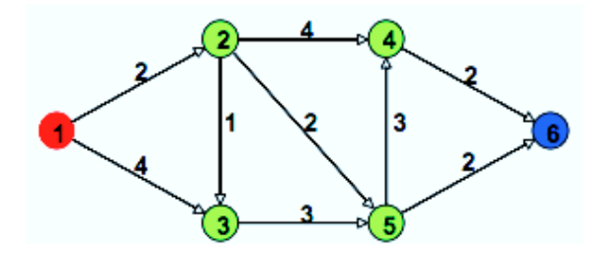
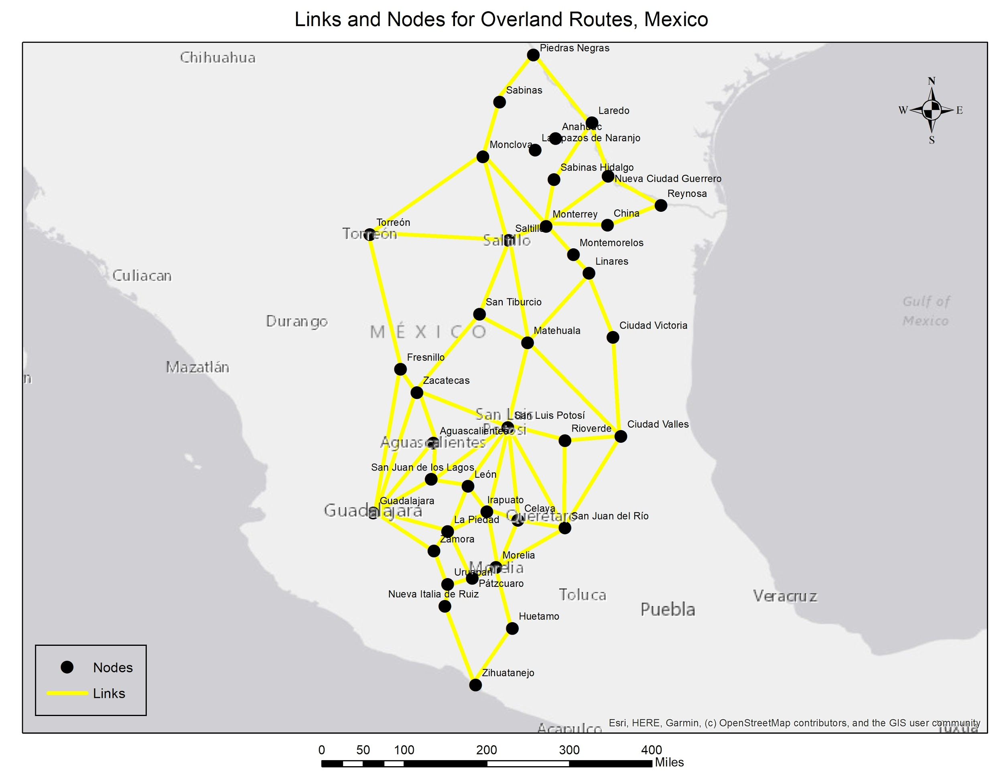
Method: Tools
1. Graph Theory
Dijkstra’s shortest path
Used to define the path through the graph that uses the weights of the edges
Simplistic algorithm to implement
Other algorithms have improved on Dijkstra, but are not used for this project. Some improves are on speed of processing
Routing using graph theory
Using graph theory to predict the most cost effective route between two points
Nodes represent cities that can be used in routes
Edges represent the connecting roadways between the cities
Distances between nodes are weighted by the independent variables
Distance between cities
Crime rate
Faction controlled
Circuity (road route vs. air route)

Slide 15
Method: Forced-choice Survey
2. Forced-choice survey
Use a survey to help develop our model inputs
Building upon the work of Medel (2015), we will develop a series of attributes to weight the routes based on data extracted from Central America.
Participants will be given contextual information about the task and asked to choose between the different weighted routes
Each leg of the route will have attributes that correspond to our IVs
Participants will be asked to rank the importance of route attributes
We are considering the following:
Participants will be told that their compensation depends on their route selection
If their selected route is “successful” during simulation, they will receive the compensation listed for that path. Otherwise, they receive nothing.
All participants will receive the same compensation, but this deception will be used to simulate risk with route decisions

Slide 16
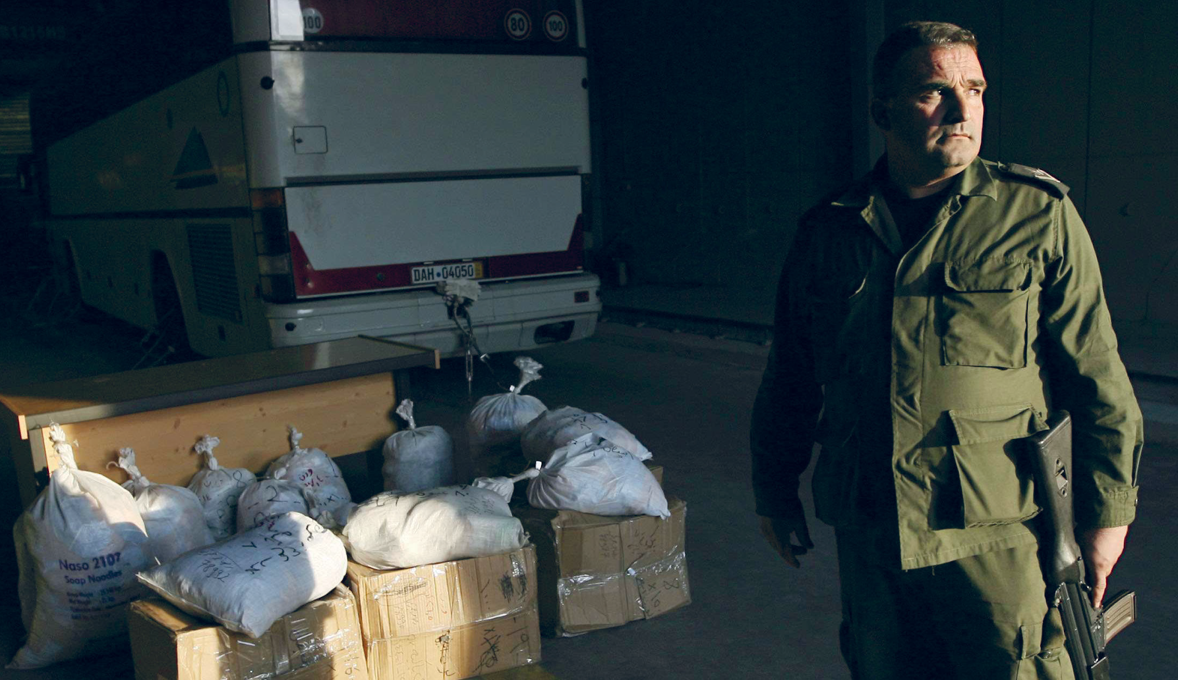
Method: Forced-choice Survey
2. Forced-choice survey
Sample:
Route 1:
Distance: 550 miles (9.5 hours)
Crime Rate along path: High
Faction Presence: 75% of Route
Route 2:
Distance: 850 miles (14 hours)
Crime Rate along path: Medium
Faction Presence: 30% of Route
Route 3:
Distance: 700 miles (12 hours)
Crime Rate along path: Low
Faction Presence along path: 75%

Slide 17
Method: Exploratory Survey
3. Exploratory Survey
Topics will span:
Extortion and solicitation
Corruption
Illegal activity passing through customs
Demographics of respondents
Regional Conflicts
Purpose:
Collect regional information to improve our understanding of how trafficking may be influenced by conditions in the MENA region
Participants:
Individuals who live in the Middle East and Africa
Sample Questions:
Has a government official ever extorted you for money in exchange for free passage?
How frequently do you believe the country allows illegal traffic through road customs?

Slide 18
PLAN OF WORK THROUGH END OF SEMESTER
Alpha presentations: 10.23.2019
Analyze feedback and survey responses
Generate the input for the graph theory
Create probable routes
Compare to previous literature
Draw conclusions based on results

Slide 19
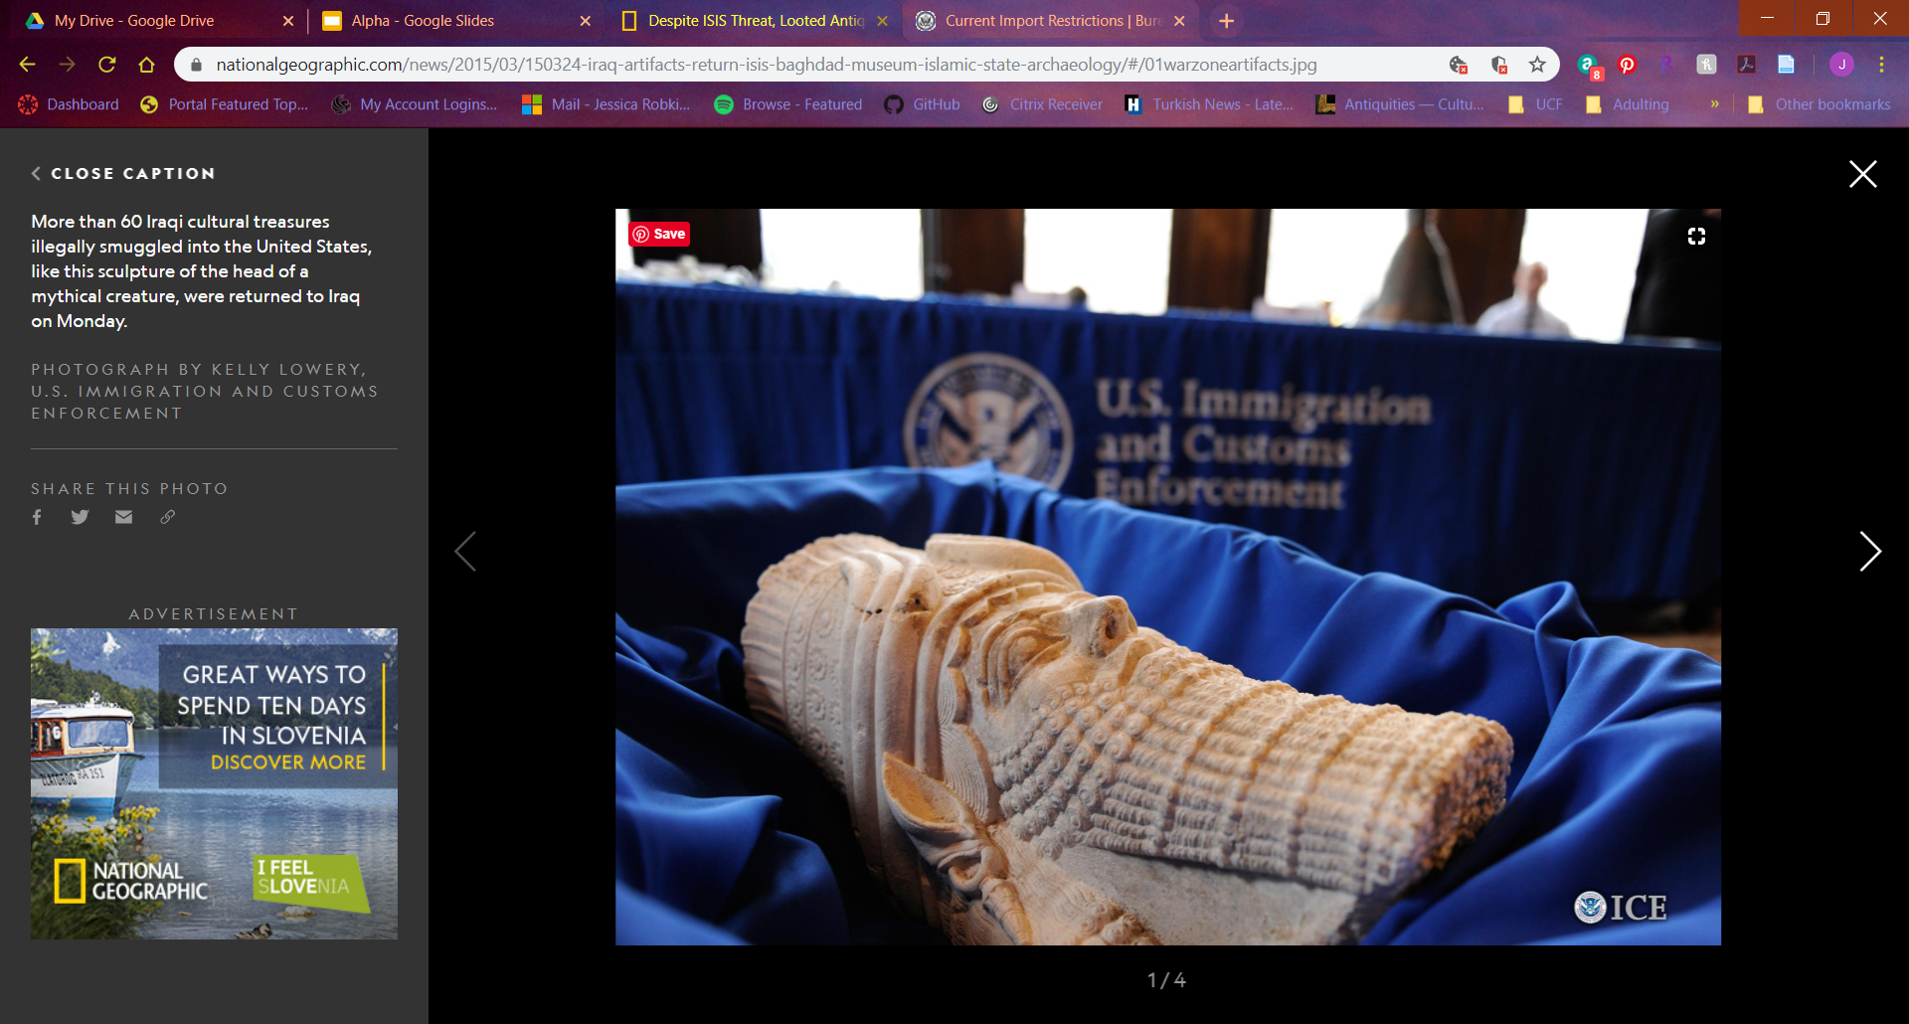


QUESTIONS?
Visit our GitHub repository for more information

Slide 20
REFERENCES
Alderman, K. L. (n.d.). Honor Amongst Thieves: Organized Crime and the Illicit Antiquities Trade. Indiana Law Review, 45, 27.
Basu, G. (2013). The role of transnational smuggling operations in illicit supply chains. Journal of Transportation Security, 6(4), 315–328. https://doi.org/10.1007/s12198-013-0118-y
Basu, G. (2014). The strategic attributes of transnational smuggling: Logistics flexibility and operational stealth in the facilitation of illicit trade. Journal of Transportation Security, 7(2), 99–113. https://doi.org/10.1007/s12198-013-0132-0
Casana, J. (2015). Satellite imagery-based analysis of archaeological looting in Syria. Near Eastern Archaeology, 78(3), 142–152.
Luke, Christina, and Morag Kersel. (2005). A Retrospective and a Look Forward. Journal of Field Archaeology, 30(2), 191-200.
Medel, M., Lu, Y., & Chow, E. (2015). Mexico’s drug networks: Modeling the smuggling routes towards the United States. Applied Geography, 60, 240–247. https://doi.org/10.1016/j.apgeog.2014.10.018
Parcak, Sarah, David Gathings, Chase Childs, Greg Mumford, and Eric Cline. (2016). Satellite Evidence of Archaeological Site Looting in Egypt: 2002–2013. Antiquity, 90(349), 188–205.
Proulx, B. B. (2013). Archaeological Site Looting in “Glocal” Perspective: Nature, Scope, and Frequency. American Journal of Archaeology, 117(1), 111. https://doi.org/10.3764/aja.117.1.0111
Rodríguez-Puente, R., & Lazo-Cortés, M. S. (2013). Algorithm for shortest path search in Geographic Information Systems by using reduced graphs. SpringerPlus, 2(1). https://doi.org/10.1186/2193-1801-2-291
Terrill, W. Andrew. (2017). Antiquities Destruction and Illicit Sales as Sources of ISIS Funding and Propaganda. Carlisle, PA: U.S. Army War College.

